Slide 1
nginx
Gerry Cao
Zeyu Zhong
Tian Cai
Meng Lei

Slide 2
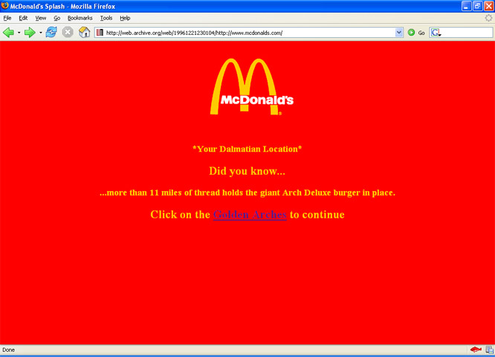
McDonald’s Website in 1996

Slide 3
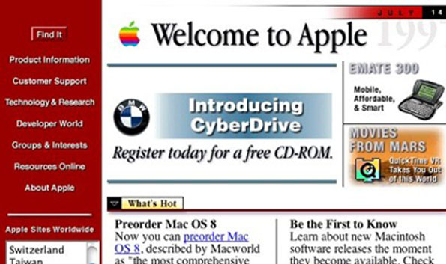
Apple Website in 1997

Slide 4
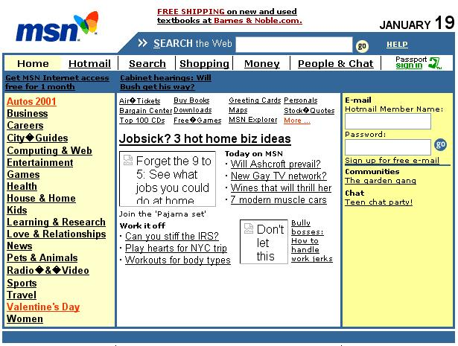
MSN Website in 1994

Slide 5
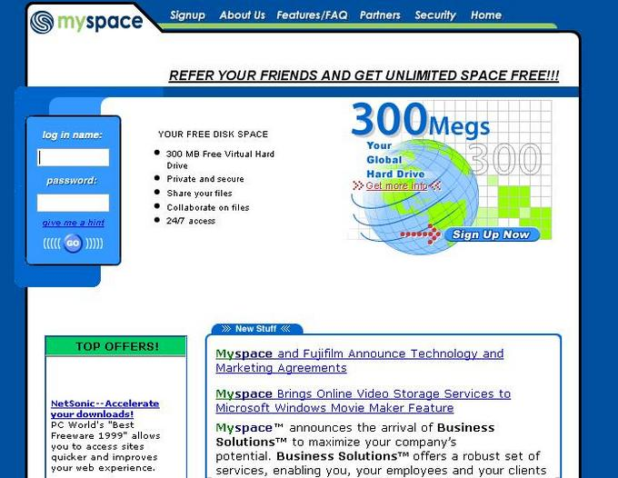
Myspace Website in 1996

Slide 6
Old Websites:
Simple HTML that produces clickable text
Based on NCSA and Apache web servers
Few # of clients
Slow clients (ADSL, dial-up)

Slide 7

Groupon Current Website

Slide 8

Yahoo! Current Website

Slide 9
New Websites:
Always-on communication medium
More than 2 billion users worldwide
Proliferation of PCs, mobile devices and tablets
High complexity

Slide 10
A major challenge for new web services
Concurrency
Thousands to millions of simultaneous users
Continuously growing concurrency
modern browsers open 4 to 6 simultaneous connections to a website to improve load speed
Persistent connection

Slide 11
Issues with high concurrency
Memory allocated by the web server to each connected client
A new process or thread for each web request (increased memory and CPU usage per connection)

Slide 12
It’s time for web servers to handle tens of thousands of clients simultaneously - Daniel Kegel

Slide 13

nginx: A free open source web server

Slide 14
What nginx helps accomplish:
Conveniently offload concurrency
Memory and CPU usage remain manageable
Delivers tens of thousands of concurrent connections with typical hardware

Slide 15
How nginx accomplish those?
nginx
Event Based Server
Internal
Model

Slide 16
Event based (Event-Driven)
Why is Even based server efficient?
Pizza shop example (an example from http://daverecycles.com)
AsynchronousCallback

Slide 17
nginx Internals
The workers model accepts new requests from a shared socket and execute a highly efficient run-loop inside each worker

Slide 18
nginx Internals - Worker
1
Begin ngx_worker_process_cycle()
2
Process events with OS specific mechanisms
3
Accept events and dispatch the relevant actions
4
6
7
8
5
Process/proxy request header and body
Generate response content
Stream the content to the client
Finalize request.
Re-initialize timers and events.

Slide 19
Code Structure
Modular architecture allows extending the web server without modifying the core
Core
maintaining a tight run-loop
executing appropriate sections of modules' code on each stage of request processing
A number of modules
Constitute most of the presentation and application layer functionality

Slide 20
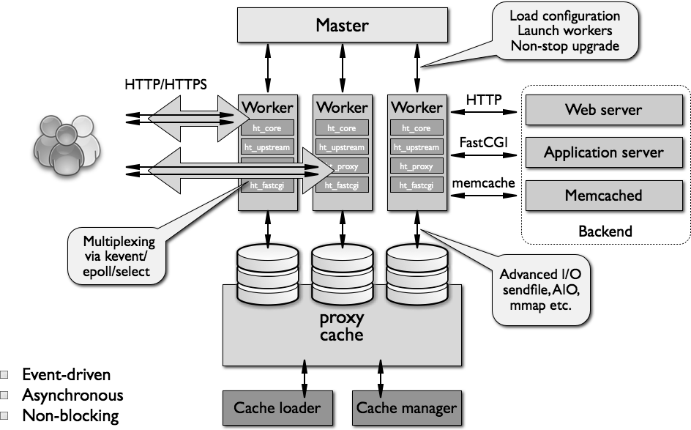
Architecture of nginx

